Slide 1


Spectra
Team

Slide 2

Purpose
Our mission is to empower manufacturers to enhance their sustainability practices through advanced, data-driven analytics

Slide 3
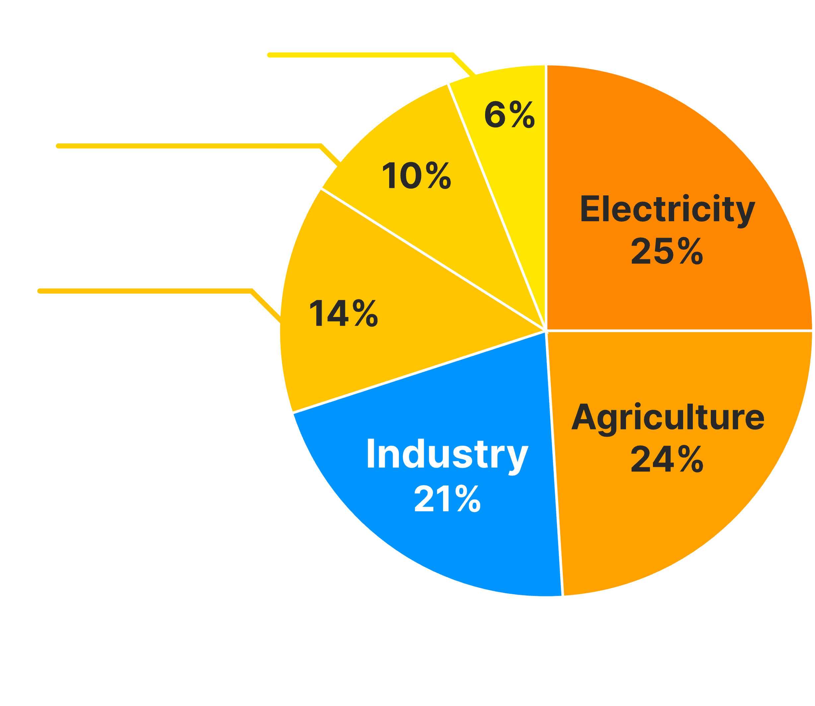
Problem
up to
20%
of industrial wastewater
is caused by textile dyeing and finishing
Greenhouse Gas
Emissions in percentages
Data provided by the US Environmental Protection Agency & European Parliametnt

Slide 4
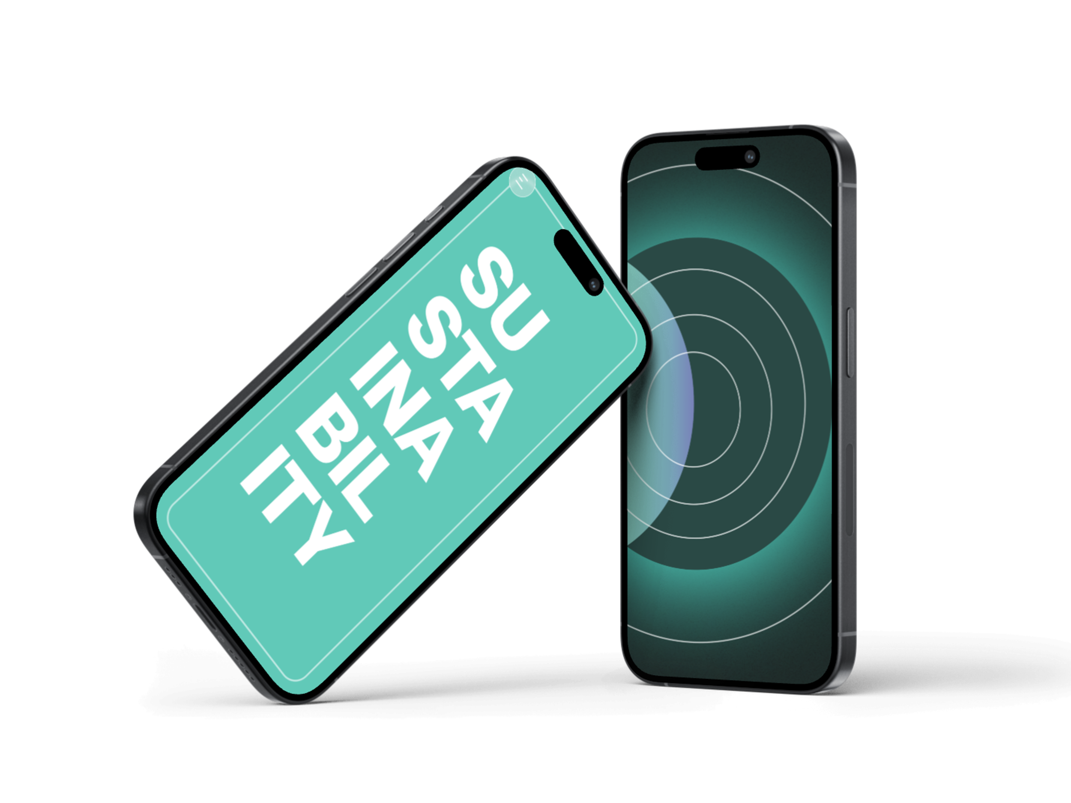
Solution
Benchmarking tools for industry standards.
Real-time monitoring of sustainability metrics
Notes:
Our product utilizes numerous technologies for both its’ frontend and backend. Azure’s storage and Computer Vision AI model are the ones, that come to mind first.
The project’s backend logic includes our own equation transpiler and a shared student-to-teacher platform.
While the project doesn’t have any professional degree of production, all of the team’s members specialize in a aspects, that when combined, create one functional product.

Slide 5
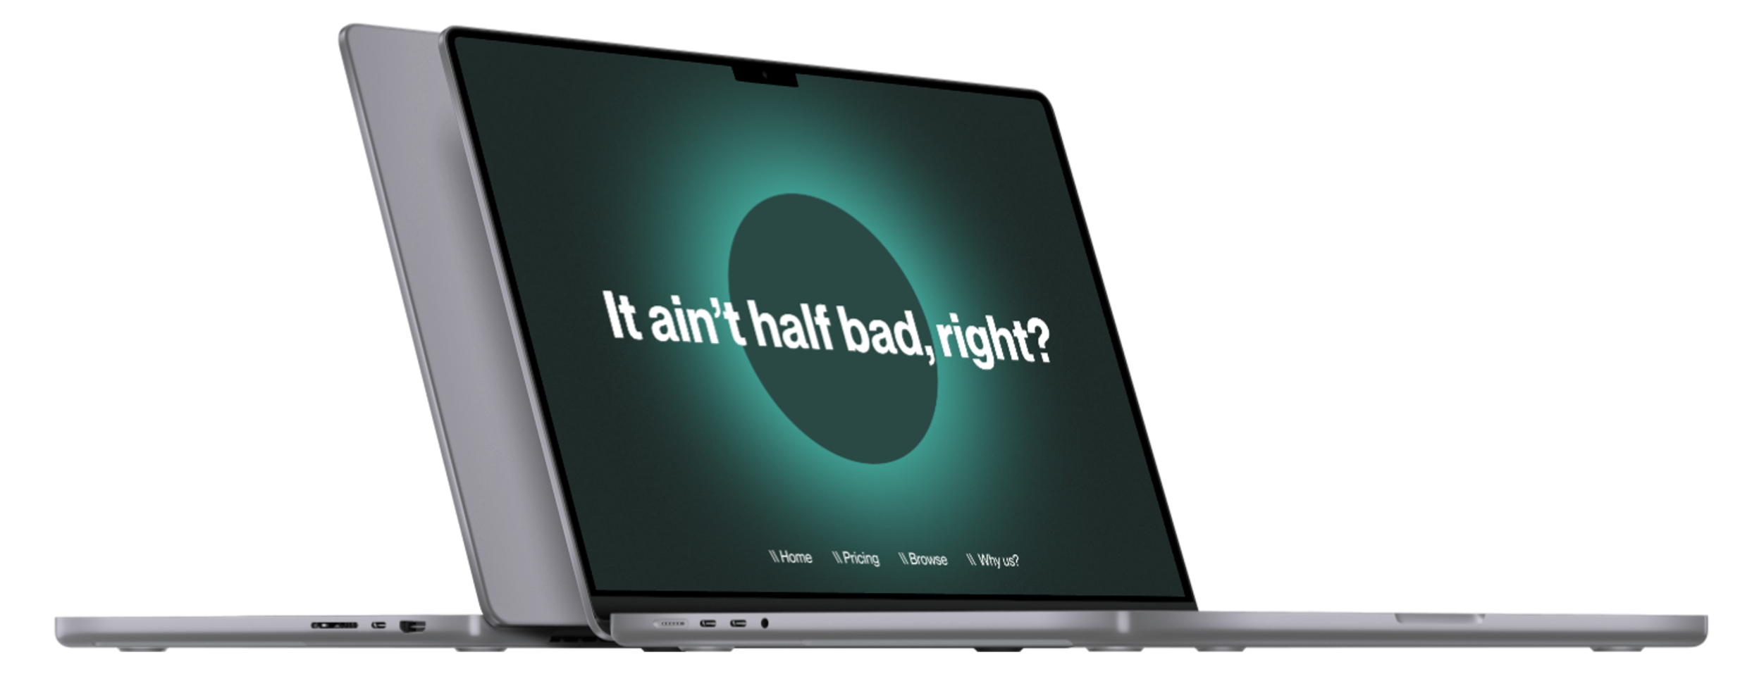
Solution
Predictive analytics for improving the sustainability and lowering operation costs of a factory.
A public index for certified sustainable manufacturing operations
Notes:
Our product utilizes numerous technologies for both its’ frontend and backend. Azure’s storage and Computer Vision AI model are the ones, that come to mind first.
The project’s backend logic includes our own equation transpiler and a shared student-to-teacher platform.
While the project doesn’t have any professional degree of production, all of the team’s members specialize in a aspects, that when combined, create one functional product.

Slide 6
Tech Stack
Bleeding edge tech,
met with thought-out design.
Notes:
Our product utilizes numerous technologies for both its’ frontend and backend. Azure’s storage and Computer Vision AI model are the ones, that come to mind first.
The project’s backend logic includes our own equation transpiler and a shared student-to-teacher platform.
While the project doesn’t have any professional degree of production, all of the team’s members specialize in a aspects, that when combined, create one functional product.

Slide 7
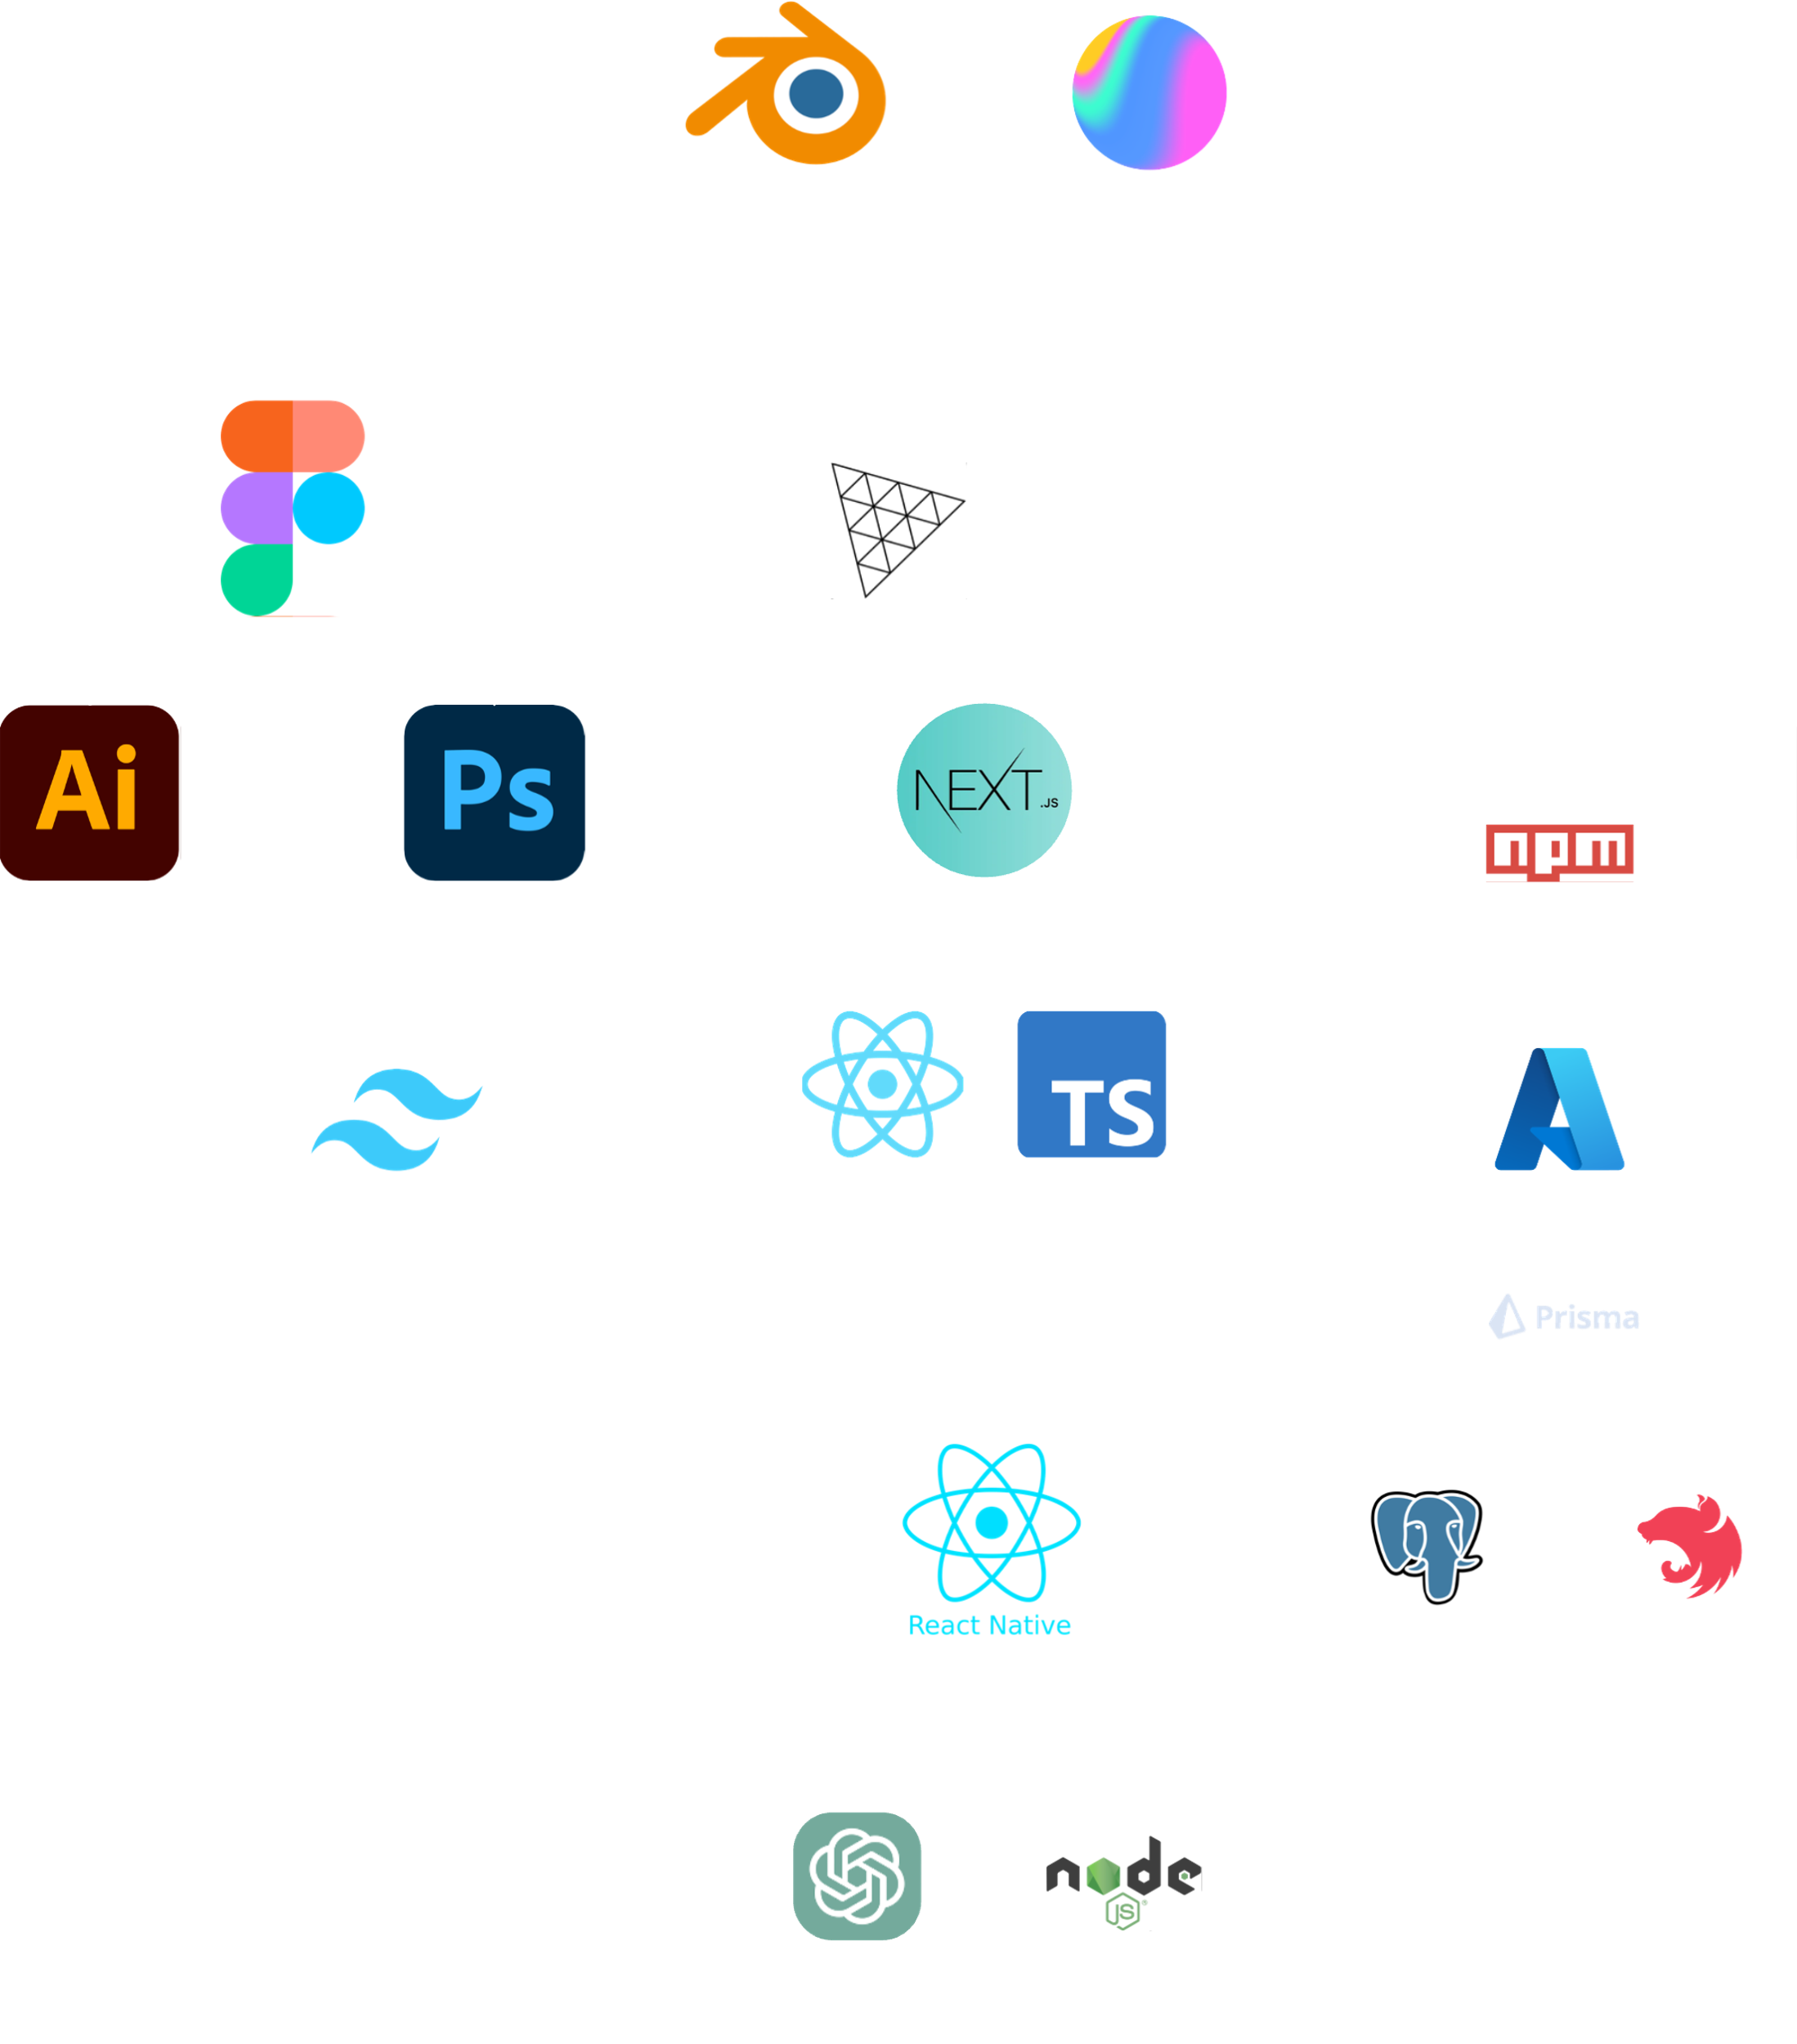
Tech Stack
Bleeding edge tech,
met with thought-out design.
Notes:
Our product utilizes numerous technologies for both its’ frontend and backend. Azure’s storage and Computer Vision AI model are the ones, that come to mind first.
The project’s backend logic includes our own equation transpiler and a shared student-to-teacher platform.
While the project doesn’t have any professional degree of production, all of the team’s members specialize in a aspects, that when combined, create one functional product.

Slide 8
Why now ?
Demand for supply chain transparency
Increasing
environmental
regulations
Notes:
At this stage, we’re planning to release a demo version for local schools. If proven successful, we’ve planned to also try a release for the entire country.
The project’s core will be free to use for all legitimate students and teachers, whereas licenses can be given out to potential buyers or individuals.

Slide 9
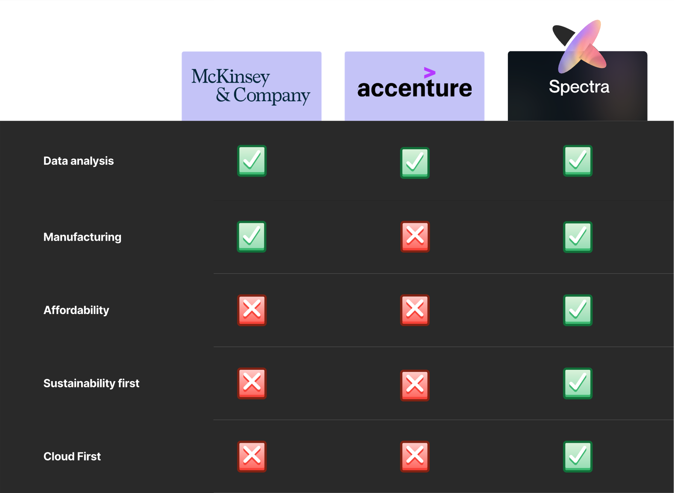
Why now ?
Notes:
At this stage, we’re planning to release a demo version for local schools. If proven successful, we’ve planned to also try a release for the entire country.
The project’s core will be free to use for all legitimate students and teachers, whereas licenses can be given out to potential buyers or individuals.

Slide 10
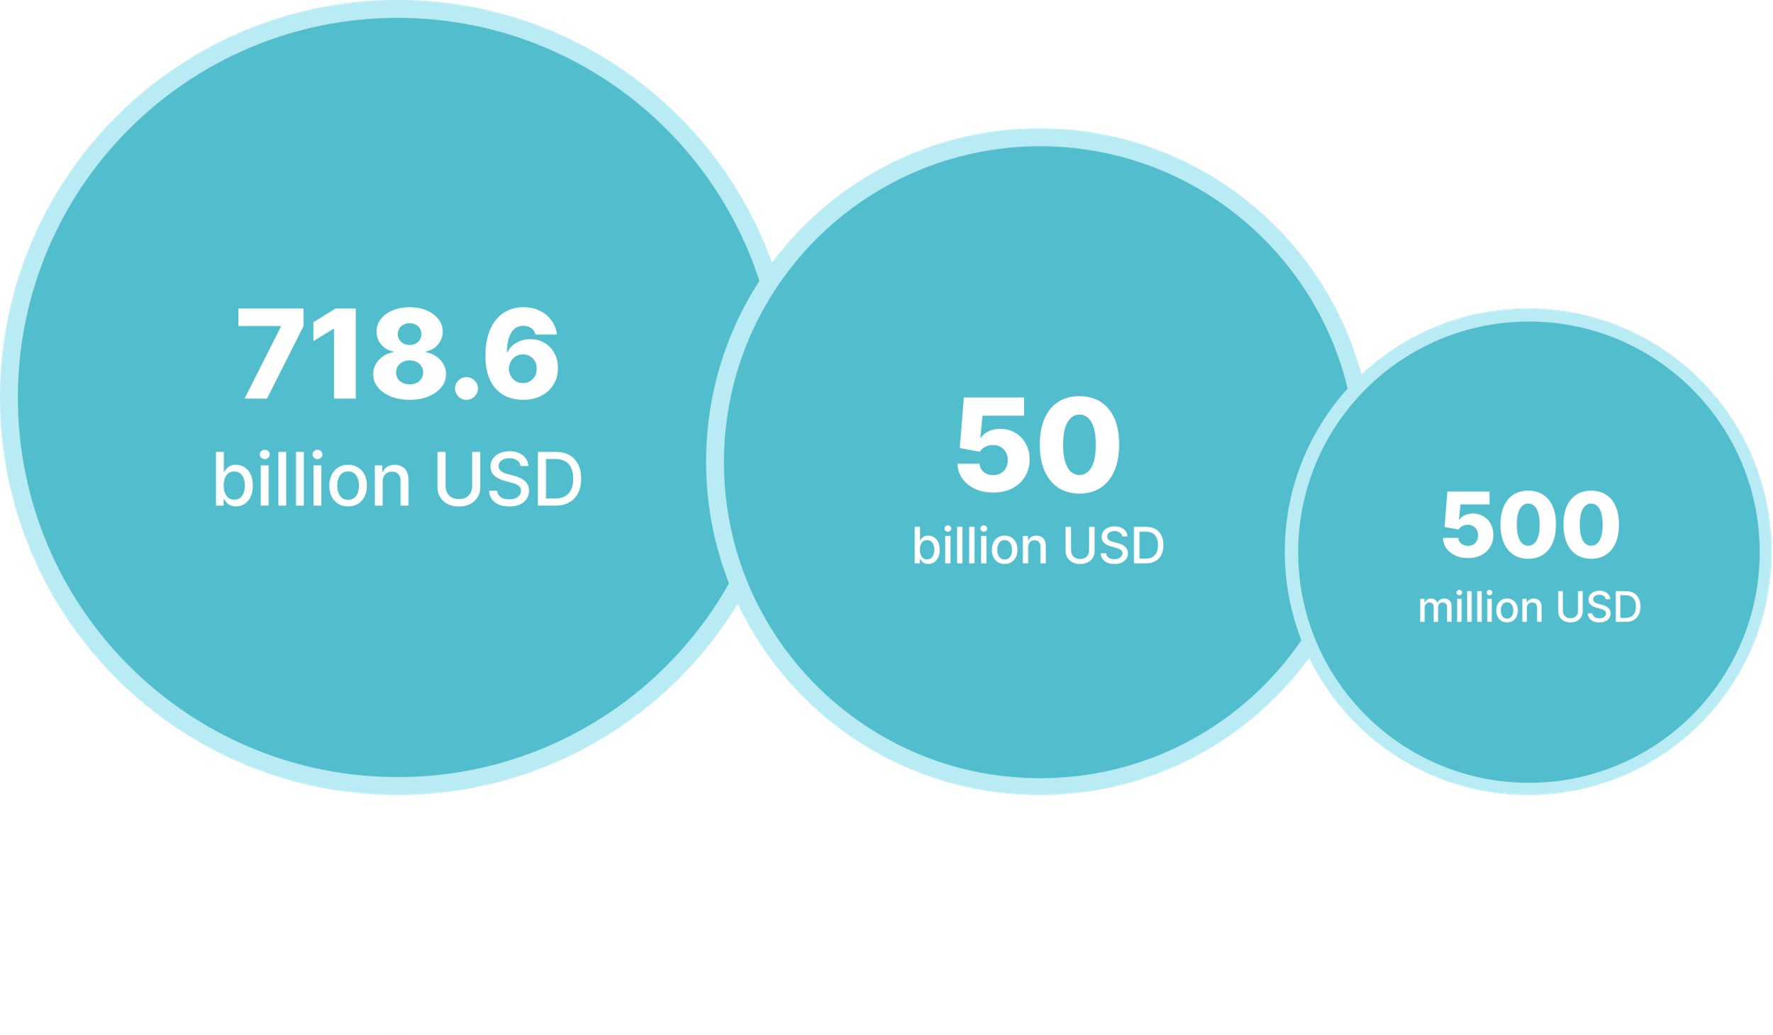
Market
Notes:
At this stage, we’re planning to release a demo version for local schools. If proven successful, we’ve planned to also try a release for the entire country.
The project’s core will be free to use for all legitimate students and teachers, whereas licenses can be given out to potential buyers or individuals.

Slide 11
Target Audience
Medium to small
manufacturers
Large Apparel Corporations
Investors & Financial
Institutions
Notes:
Overall, the project could be used by anyone who wants to learn in a interactive and engaging way, by visualizing the real-life objects and the information about them, and therefore, it could be beneficial for both students and teachers, as well as for people interested in learning and visualizing complex concepts.
------
Students of all ages and in various educational settings, who could use the platform to enhance their understanding of complex concepts in various subjects, such as mathematics, science, and engineering.
Teachers, who could use the platform as a tool to supplement their existing lesson plans and make their curriculum more interactive and engaging for everyone.
Parents, who could use the platform to help their children with their homework or to supplement their own education.
Anyone interested in learning mathematics, who could use the platform to visualize mathematical concepts in a more tangible way.
Architects, who could use the platform to visualize and understand the shapes and proportions of building components.

Slide 12
Business model
Revenue sources
One-Time purchases with large-scale corporations
Subscriptions for small to medium businesses
Pricing
40$ per month
400$ per year
Custom pricing for enterprise
Notes:
Overall, the project could be used by anyone who wants to learn in a interactive and engaging way, by visualizing the real-life objects and the information about them, and therefore, it could be beneficial for both students and teachers, as well as for people interested in learning and visualizing complex concepts.
------
Students of all ages and in various educational settings, who could use the platform to enhance their understanding of complex concepts in various subjects, such as mathematics, science, and engineering.
Teachers, who could use the platform as a tool to supplement their existing lesson plans and make their curriculum more interactive and engaging for everyone.
Parents, who could use the platform to help their children with their homework or to supplement their own education.
Anyone interested in learning mathematics, who could use the platform to visualize mathematical concepts in a more tangible way.
Architects, who could use the platform to visualize and understand the shapes and proportions of building components.

Slide 13
Demo
Notes:
Our application favors every user equally.
Private data isn’t collected from the users in order to keep our system separated from any potential discriminative accusations.
Aside from planned multilingual updates, we’ve focused on accessibility for handicapped people of all ages.
Since our platform is number-focused, the second scope of accessibility is to add support for other numeric system.

Slide 14
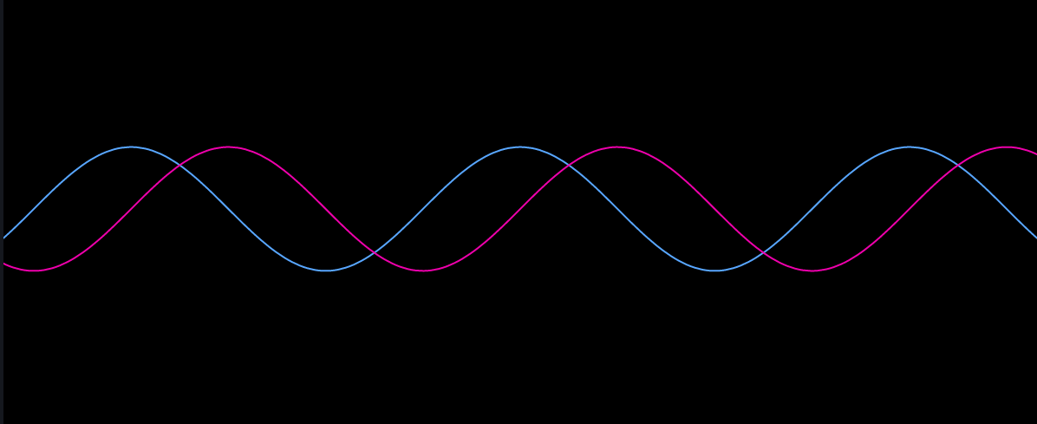
Future
Polishing
Striking deals
Global Index
Realisation
Notes:
Our application favors every user equally.
Private data isn’t collected from the users in order to keep our system separated from any potential discriminative accusations.
Aside from planned multilingual updates, we’ve focused on accessibility for handicapped people of all ages.
Since our platform is number-focused, the second scope of accessibility is to add support for other numeric system.

Slide 15
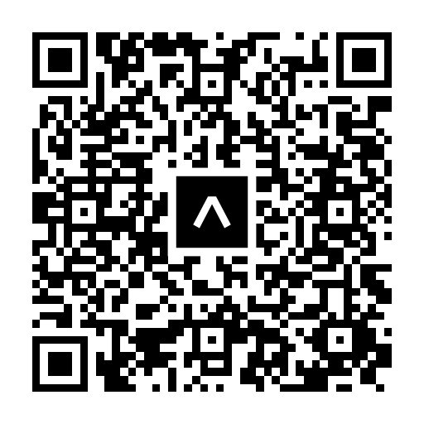
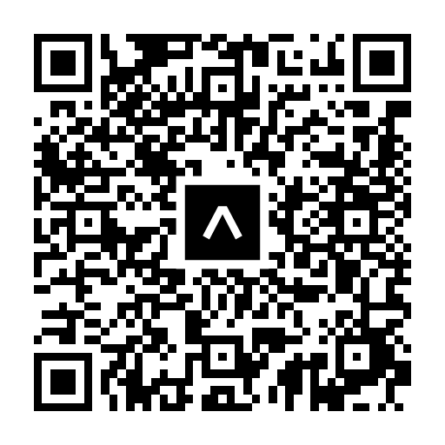
Thanks.
Android
iOS

